Slide 1
Selected poverty data February 4, 2015 / latest March 24, 2015 XP vision working group

Slide 2
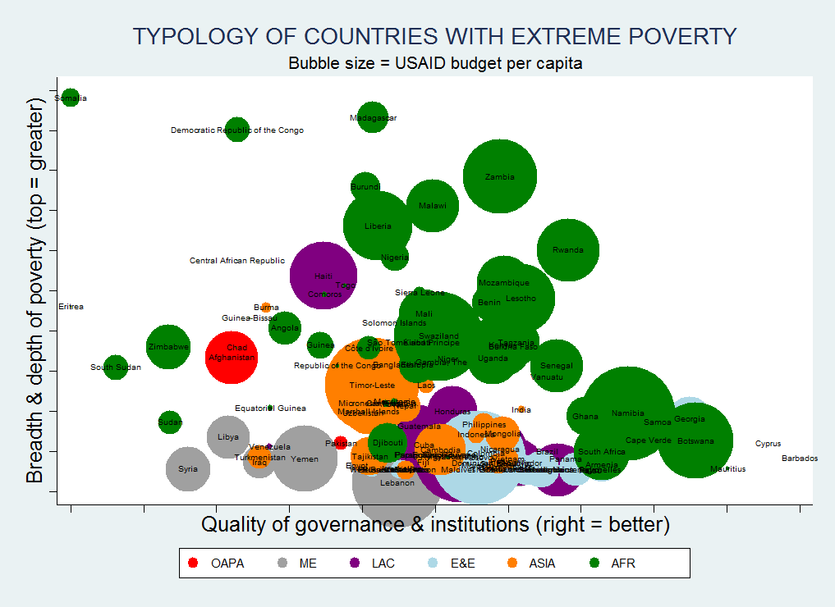
Notes:
Source: Aaron Roesch using CPIA scores (and/or Kaufmann/Kraay) on the x-axis and the poverty gap [?] on the y-axis.

Slide 3
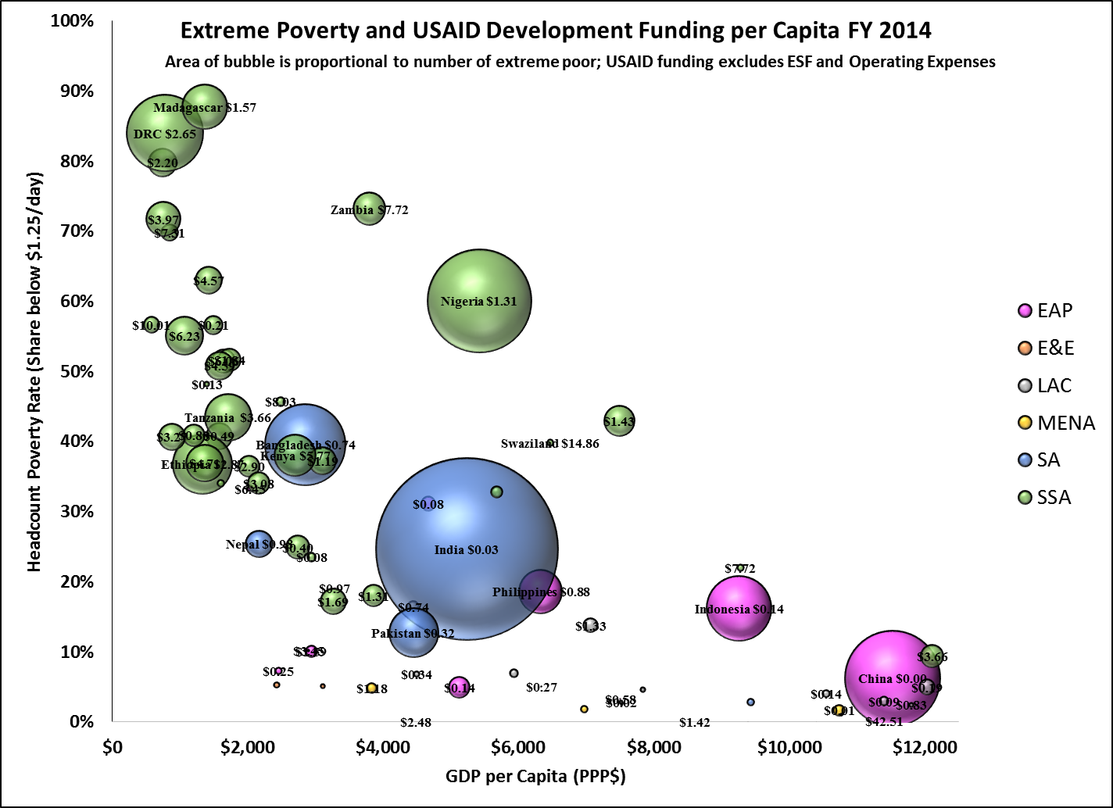
Moderate poverty can be a lot higher than extreme poverty
Notes:
Source: Don Sillers using PovCal data on poverty rates, USAID data on development funding, and WDI data on PPP-adjusted real GDP per capita.

Slide 4
Moderate poverty can be a lot higher than extreme poverty
1 of 7
Notes:
Source: Steve O’Connell using PovCal data from Don and fitting a 3rd-degree polynomial smoother.

Slide 5
Labor earnings play a major role in reducing extreme poverty in non-LICs (Ghana is the only LIC in the sample)
Source: Inchauste, Gabriela et al. (2014) Understanding Changes in Poverty (Washington, DC: The World Bank)
Notes:
Source: Steve O’Connell using data from Inchauste et al. (2014)

Slide 6
“Transfers” (Transfers + pensions) become more important relative to labor earnings for households further below the XP line
Source: Inchauste, Gabriela et al. (2014) Understanding Changes in Poverty (Washington, DC: The World Bank)
Notes:
Source: Steve O’Connell using data from Inchauste et al. (2014)

Slide 7
Earnings are increasingly important for reducing poverty, relative to transfers, as the initial headcount ratio is higher.
Source: Inchauste, Gabriela et al. (2014) Understanding Changes in Poverty (Washington, DC: The World Bank)
Notes:
Source: Steve O’Connell using data from Inchauste et al. (2014). The slope and robust t-stat are 7.93 (5.93) for the 8 LAC countries (excluding Peru) and 2.99 (1.75) for all 13 countries (again excluding Peru).

Slide 8
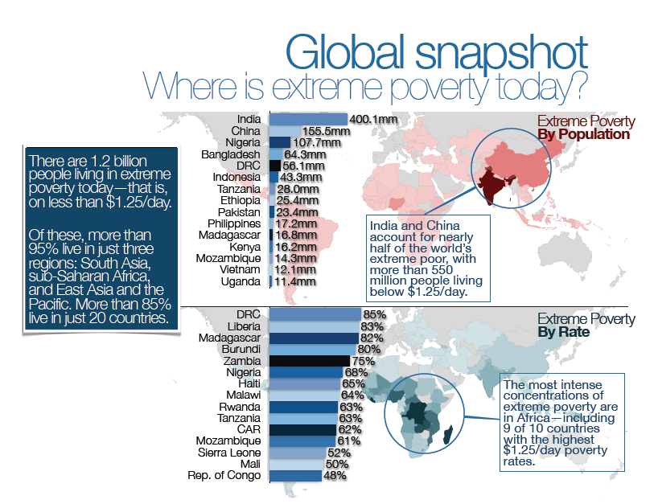
GLOBAL SNAPSHOT WHERE IS EXTREME POVERTY TODAY?
85% of the extreme poor live in just 20 countries
Notes:
Source: Aaron Roesch

Slide 9
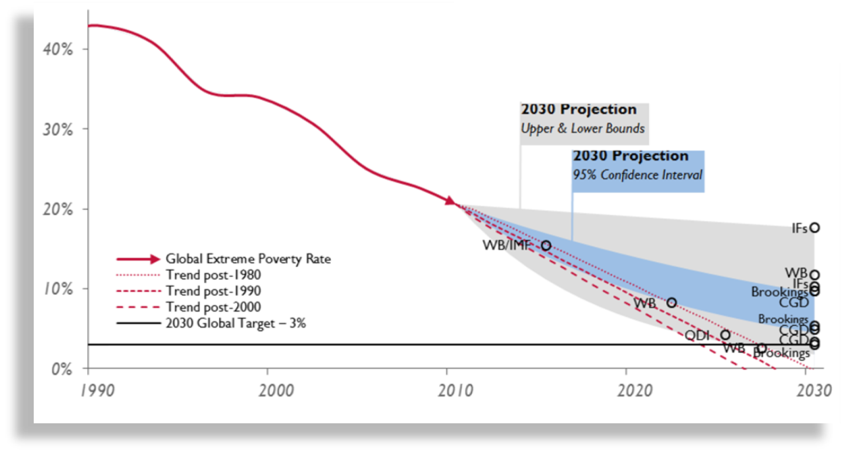
Today, we stand within reach of a world that was simply once unimaginable:
a world without extreme poverty.
Administrator Rajiv Shah at the Brookings Institution:
Ending Extreme Poverty
November 21, 2013
Notes:
Source: Aaron Roesch

Slide 10
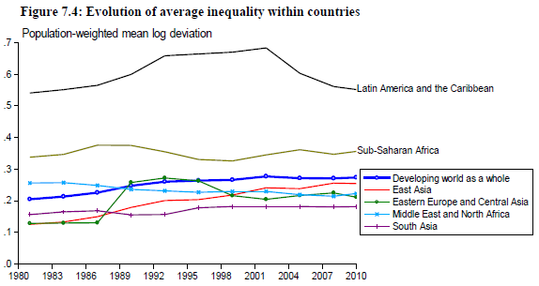
Within-country inequality has been rising, but mainly due to East Asia
Source: Ravallion, Martin The Economics of Poverty (forthcoming, Oxford University Press)
Notes:
Source: Ravallion manuscript, part 3. Note that this is population-weighted, and therefore the East Asia, South Asia, and developing-country averages are heavily influenced by China and India. It would be better for most analytical purposes to track cross-country averages of within-country changes.

Slide 11
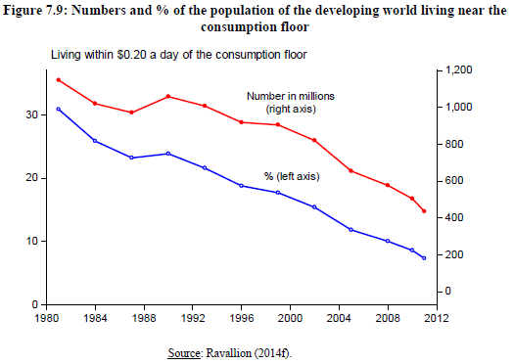
Headcount ratios and numbers of ultra-poor have fallen
Source: Ravallion, Martin The Economics of Poverty (forthcoming, Oxford University Press)
Notes:
Source: Ravallion manuscript, part 3

Slide 12
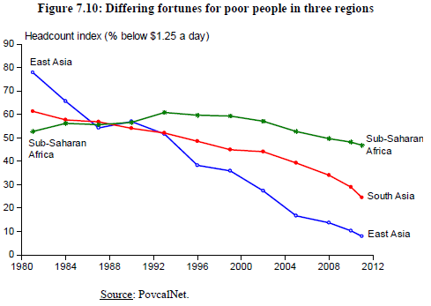
Divergence in headcount ratios between Sub-Saharan Africa and Asia
Source: Ravallion, Martin The Economics of Poverty (forthcoming, Oxford University Press)
Notes:
Source: Ravallion manuscript, part 3

Slide 13
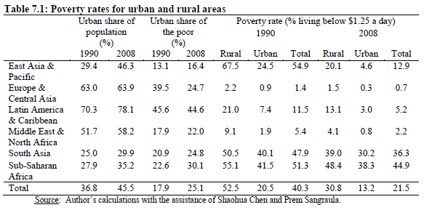
Urban poverty falls more slowly than rural poverty, and urban population rises faster than rural population, so poverty is urbanizing.
Source: Ravallion, Martin The Economics of Poverty (forthcoming, Oxford University Press). These aggregates are population weighted, so large-population countries exert a strong influence.
Notes:
Source: Ravallion manuscript, part 3

Slide 14
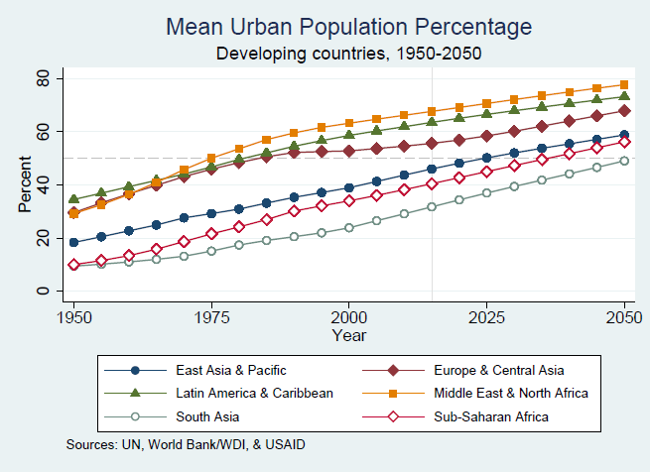
South Asia and SSA are the most rural regions but are urbanizing fastest.
Source: United Nations. Regional observations are population weighted (they ignore political borders).
Notes:
Source: Aaron’s Stata file using UN population data.

Slide 15
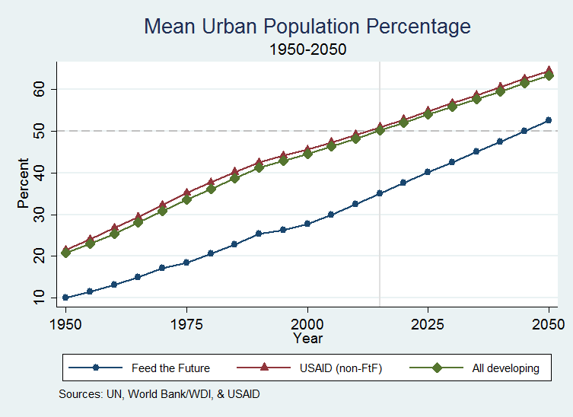
USAID’s Feed the Future focus countries are more rural but urbanizing faster.
Source: UN population projections. Aggregates are simple averages of country-level percentages.
Notes:
Source: Aaron’s Stata file using UN population data.

Slide 16
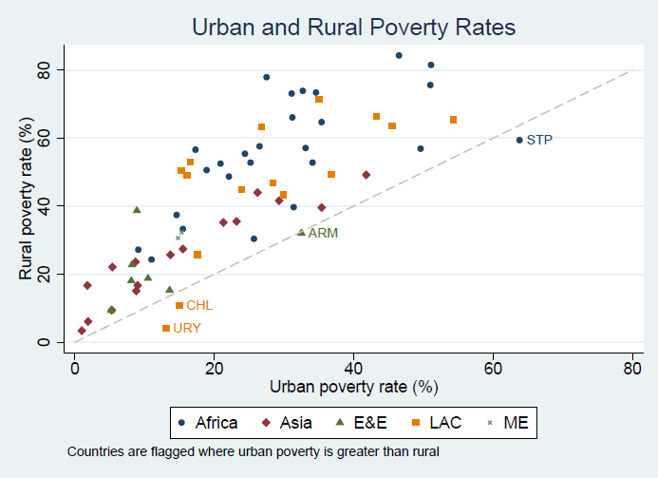
Rural poverty rates (at national lines) are significantly higher than urban.
Source: United Nations; shows latest observations for each country, 2009-2011.
Notes:
Source: Steve O’C from UN data; shows latest observations, one per country, 2009-2011.

Slide 17
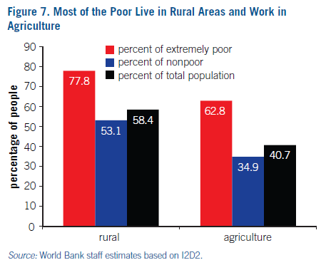
$1.25-a-day poverty is more than 3/4 rural and almost 2/3 agricultural.
Source: Olinto, et al. (2013).
Notes:
Source: Olinto, Pedro, Kathleen Beegle, Carlos Sobrado and Hiroki Uematsu (2013) “The State of the Poor: Where Are the Poor, Where Is Extreme Poverty Harder to End, and What Is the Current Profile of the Poor?” World Bank, Poverty Reduction and Economic Management Network No. 125, October (www.worldbank.org/economicpremise)

Slide 18
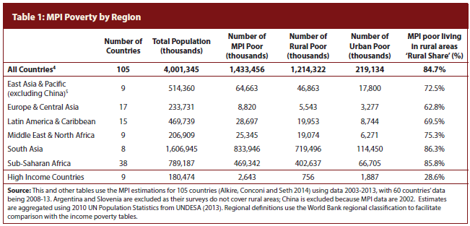
Multilateral poverty is even more rural than $1.25-a-day poverty.
Source: Alkire et al. (2014) “Poverty in Rural and Urban Areas: Direct Comparisons Using the Global MPI 2014” Oxford Poverty & Human Development Initiative www.ophi.org.uk
Notes:
Source: Alkire, Sabina et al. (2014) “Poverty in Rural and Urban Areas: Direct Comparisons Using the Global MPI 2014” Oxford Poverty & Human Development Initiative www.ophi.org.uk

Slide 19
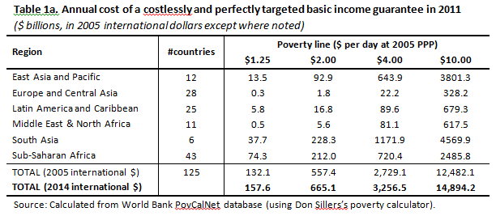
How big is the income gap of the poor?
Notes:
Source: Calculated from World Bank, PovCalNet, using Don Sillers’ poverty calculator.
--Official ODA in 2014 was around $130 billion.
--Notice that South Asia becomes more ‘expensive’ than SSA at $2 or higher lines.

Slide 20
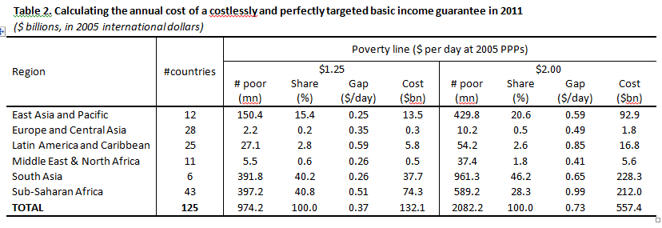
Details on the income/consumption gap at $1.25 and $2.00
Source: Calculated from World Bank, PovCalNet, using Don Sillers’ poverty calculator.
Notes:
Source: Calculated from World Bank, PovCalNet, using Don Sillers’ poverty calculator.
--The depth of poverty is 37c on average worldwide and his higher in LAC than in SSA, presumably because inequality in big LAC countries is so high. The LAC data are generally for income and the SSA for consumption, which may account for part of this if low levels of income are more frequent (permanent-income hypothesis) or are reported more accurately than low levels of consumption.

Slide 21
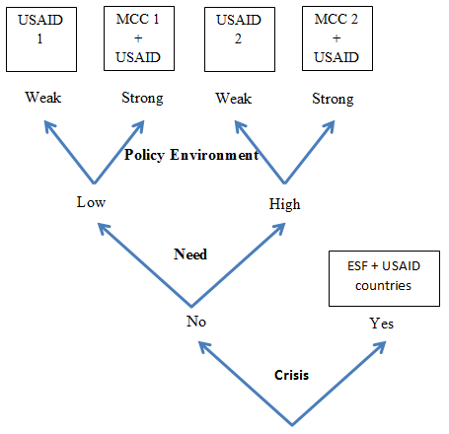
US foreign assistance allocations reflect crisis, poverty, and effectiveness.
Source: Steve O’Connell (2015) “Notes on selectivity”
Notes:
Source: Steve O’Connell (2015) “Notes on selectivity”

Slide 22
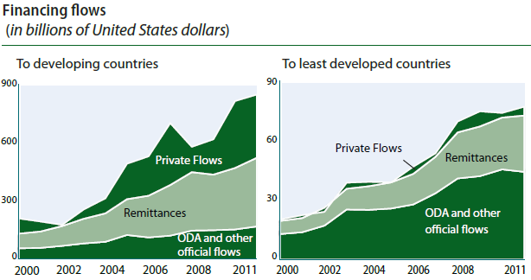
ODA remains dominant in external flows to least-developed countries.
Source: United Nations (2014), Report of the Intergovernmental Committee of Experts on Sustainable Development Financing, p. 7
Notes:
Source: United Nations (2014), Report of the Intergovernmental Committee of Experts on Sustainable Development Financing, p. 7
Data sources cited: DAC Statistics and World Bank data on migration and remittances.
Note that domestic revenues as a share of GDP are also much smaller in least-developed countries.

Slide 23
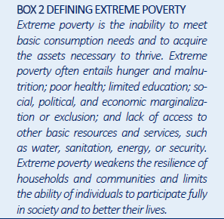
A multi-dimensional definition.
Source: USAID’s Vision for Ending Extreme Poverty (DRAFT)

Slide 24
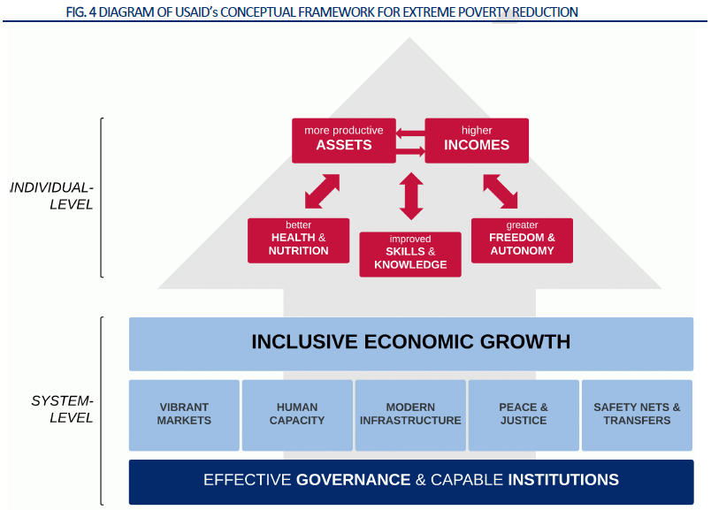
Ending extreme poverty: an integrated view.
Source: USAID’s Vision for Ending Extreme Poverty (DRAFT)

